Slide 1
Satellites

Slide 2
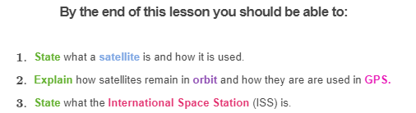

Slide 3
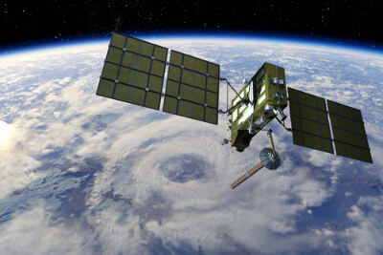
What is a satellite?
A satellite is an object in orbit around a larger object such as a planet or a star. The Moon is a natural satellite of Earth. Artificial satellites are man-made objects in orbit around Earth.

Slide 4
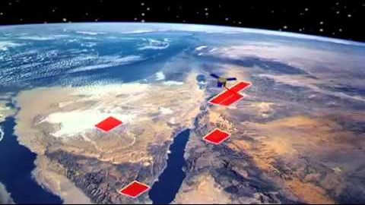

Slide 5
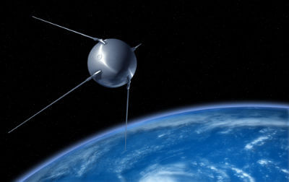
The very first artificial satellite to be launched into orbit around Earth was Sputnik 1.
It was launched from Kazakhstan in the former Soviet Union on October 4th, 1957.
Sputnik 1 was a small aluminum sphere with 4 antennae to broadcast radio pulses back to Earth. It was a simple satellite but it marked the beginning of the space age.

Slide 6
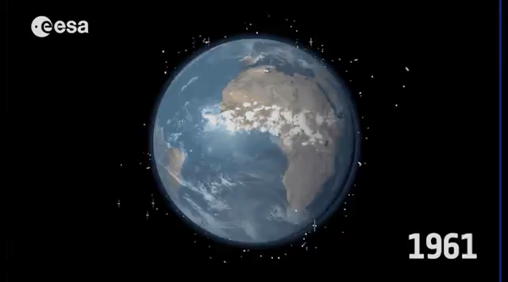
After Sputnik 1, many more satellites have been sent into orbit around Earth.
There are over 1,000 working satellites in orbit, plus about 2,600 satellites that no longer work.

Slide 7
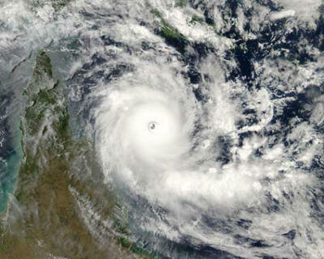
Satellites have many uses.
Some satellites take pictures of Earth to help meteorologists predict the weather. Others take pictures of objects in space like planets and stars to help scientists study the universe.
Many satellites are used for communication, such as transmitting phone calls and TV signals around the world.

Slide 8
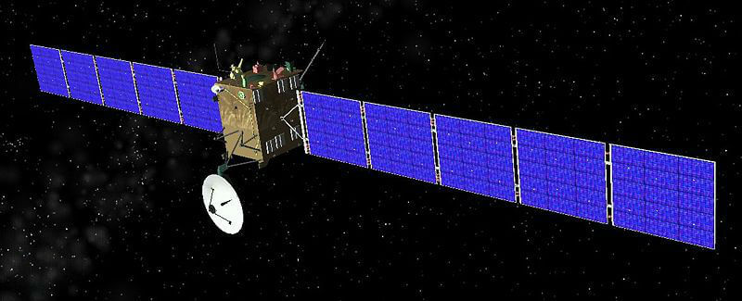
There are many different types of satellites, but they all have two main parts in common - a power source and an antenna.
The power source is usually solar panels which use sunlight to produce electricity. The antenna sends and receives information from Earth.
Many satellites also have cameras or scientific sensors pointed either towards or away from Earth.

Slide 9
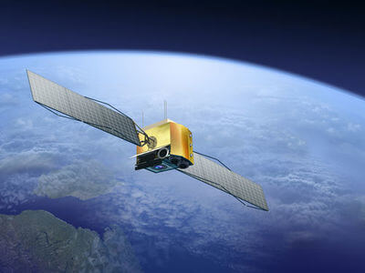
Satellites are held in orbit by the Earth's gravitational force.
A satellite orbit is shaped like an ellipse around the Earth.
Their speed causes them to travel around the Earth rather than towards it.

Slide 10
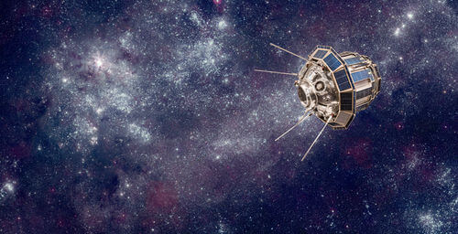
Satellites must be launched into space on rockets.
They must reach a certain height and speed in order to go into orbit around Earth.
The height at which a satellite orbits Earth depends on its purpose.

Slide 11
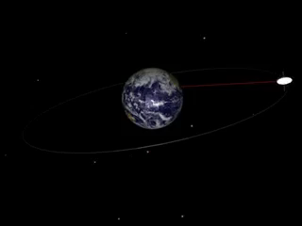
Geostationary satellites are a type of satellite that orbit at 36,000km above Earth at the same speed as Earth rotates.
This means they stay in the same location relative to a certain position on Earth's surface. They are useful for telecommunication (e.g. phone, TV, internet) and weather observations.

Slide 12
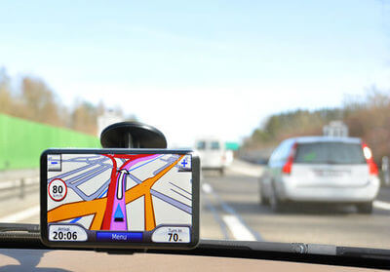
Have you ever used Google Maps or a GPS unit in your car to find directions to somewhere?
If you have, you have used the Global Positioning System (GPS)!
GPS is a system that uses satellites to determine the exact location of a receiver such as your smart phone.

Slide 13
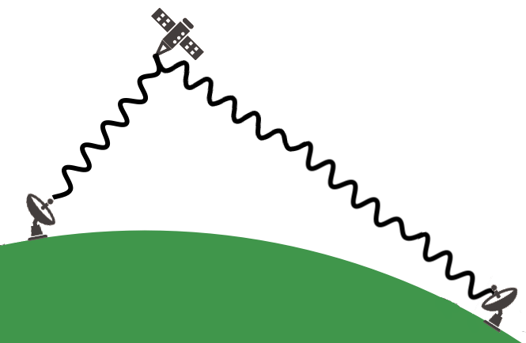
The GPS system is made up of 3 parts:
• | Satellites
• | Ground stations
• | Receivers

Slide 14
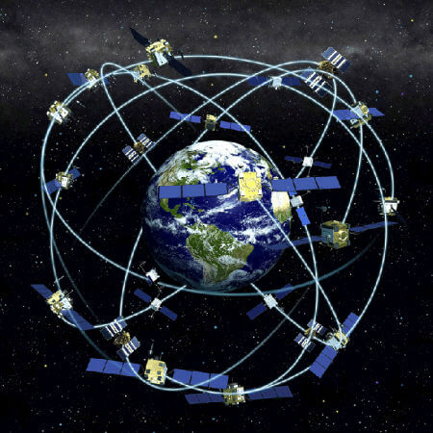
There are 24 active GPS satellites orbiting 20,000km above Earth.
Their orbits are designed so that there are always at least 6 satellites in view from any place on Earth. We know exactly where each satellite is supposed to be at any point in time.

Slide 15
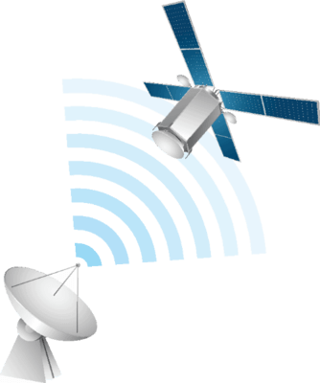
Each satellite continuously transmits its current location and time using radio frequency signals.
The ground stations track the actual location of the satellites to make sure they are where they say they are. They also control the clocks on board the satellites so that they remain very accurate.

Slide 16
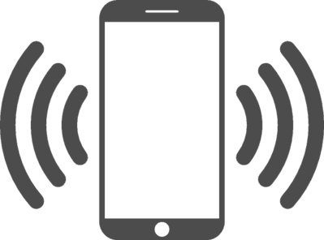
The receiver, such as your mobile phone, must receive signals from at least 4 satellites to calculate your location.
It calculates how far away each satellite is based on the time it took for each signal to arrive. This is why the clocks on the satellites and the receivers must be incredibly accurate!

Slide 17
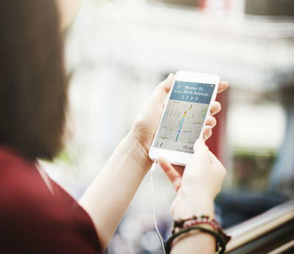
The receiver calculates how far it is from each of the satellites it detects, allowing it to pinpoint its exact location.
This calculation is called trilateration.

Slide 18
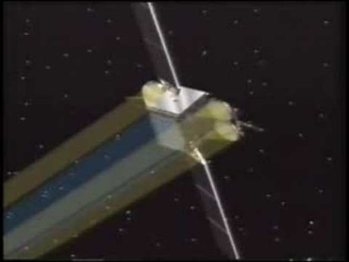

Slide 19
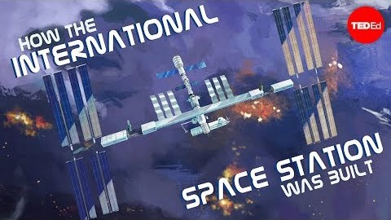

Slide 20
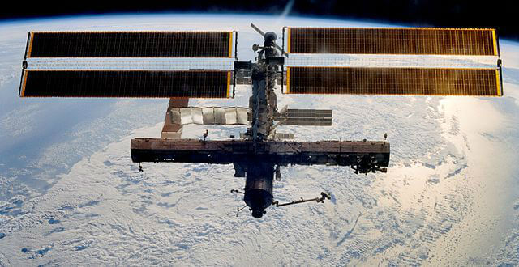
International Space Station
The International Space Station was built by five different space agencies representing 15 different countries.
Astronauts from 18 countries have visited the ISS so far, including Andrew Thomas from Australia!

Slide 21
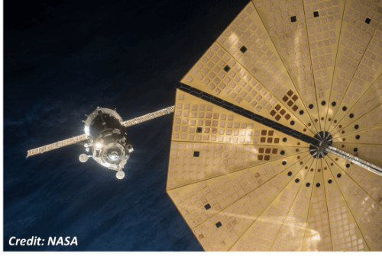
The ISS is so large that it had to be assembled in space.
The first part was launched by Russia in 1998. Since then, more than 115 space flights have been involved in its construction.

Slide 22
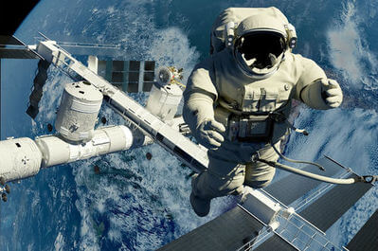
A major objective of the ISS is to research space and the effects of living in space.
In March 2016, Russian cosmonaut Mikhail Kornienko and American astronaut Scott Kelly returned from the first year-long mission aboard the ISS, which provided valuable information about the effects of space travel and weightlessness on the human body.

Slide 23
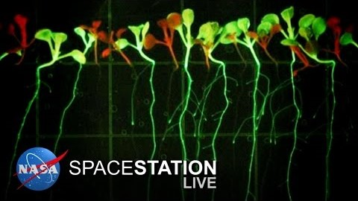

Slide 24
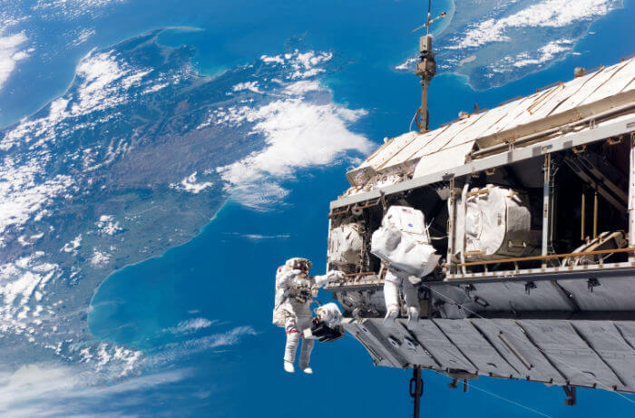
The ISS is mainly a research station, but its constant crewing means that it is usually better than unmanned satellites at taking pictures of Earth.

